Slide 1
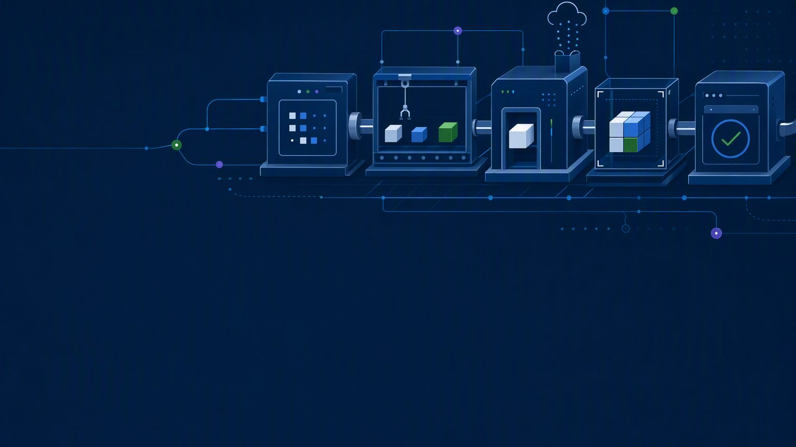

ENTERPRISE BUSINESS CASE
Agentic SDLC Factory
Value model, ROI and operating options for enterprise-scale delivery
$386M net annual saving · 9.2x year-one ROI · payback in 1.2 months
Project start in minutes · one security plane across every system of record
Michael Yaacoub | Sr Solution Engineer

Slide 2

Agentic SDLC Factory returns $386M a year on a $42M year-one investment
Situation - 6,000 projects a year, 25,000 engineers, $2.81B of delivery labour.
Complication - AI assistance alone captures 12% of addressable effort; security and cost stay fragmented.
Resolution - one governed factory: 14 agents, 9 evidence gates, one security and cost plane.
$386M
9.2x
minutes
2.3 weeks
net annual saving, base case
year-one ROI, payback 1.2 months
to start a project, versus 2-6 weeks
of delivery time removed per project
Source: illustrative model built from the assumptions on the next slide.
Michael Yaacoub | Sr Solution Engineer

Slide 3
Four value claims, in order of importance
1
Speed to start a project
2
Speed of release
One requirements document in; provisioned project, repo and backlog out.
One ordered graph plans, builds, tests, secures and deploys.
Minutes, versus 2-6 weeks
2.3 weeks removed per project
3
Centralized security
4
Cost visibility
Guardrails, allow-lists and token limits enforced server-side everywhere.
Every model call logs tokens to a project and an owner.
One plane, every system of record
$2,980 platform cost per project
Michael Yaacoub | Sr Solution Engineer

Slide 4
Value scales with the portfolio, not with the team
Portfolio cost avoidance
5
$298M-$550M net a year across 6,000 projects, depending on the autonomy mode.
Consistency and reuse
6
The same 14 agents, 9 gates and model policy run on every project.
Audit-ready traceability
7
Append-only audit trail; work items carry commit, PR and deployment links.
Quality and improvement
8
Security stage before deploy; the Insights agent feeds Planning a ranked backlog.
Michael Yaacoub | Sr Solution Engineer

Slide 5
Six assumptions drive the entire estimate
Enterprise scale
$1T market cap; 25,000 FTE across engineering, QA,
DevOps and delivery management
Cost base
$190,000 fully loaded per FTE
= $4.75B total engineering base
Project portfolio
6,000 funded projects a year; 8 FTE for 16 weeks
= $467,692 per project = $2.81B a year
Addressable effort
45% of project effort - requirements, planning, design, code, tests,
security prep, release and ops docs = $210,462 per project
Platform run cost
$17.9M a year = $2,980 per project,
of which $450 is model tokens
Year-1 investment
$42M = run cost + $18M enablement and change management
+ $6M build, connectors and hardening
Illustrative planning model, not a quotation. Validate the assumptions with a 10-project pilot.
Michael Yaacoub | Sr Solution Engineer

Slide 6
Net annual saving rises from $134M to $550M as gates move from people to policy
Manual + AI $134M · Human Review $298M · Minimal Human Review $386M · Fully Autonomous $550M net of $17.9M platform run cost, across 6,000 projects a year
Michael Yaacoub | Sr Solution Engineer

Slide 7
Minimal Human Review is the default: four gates, $386M, 9.2x return
Manual + AI
Human Review
Minimal Review
Autonomous
today
9 of 9 gates
4 of 9 gates · DEFAULT
0 of 9 gates
Gates ad hoc
Uplift 12%
Per project $22,275
Gates 9 of 9
Uplift 25%
Per project $49,635
Gates 4 of 9
Uplift 32%
Per project $64,368
Gates none
Uplift 45%
Per project $91,728
$134M
$298M
$386M
$550M
3.2x ROI · payback 3.3 mo
7.1x ROI · payback 1.6 mo
9.2x ROI · payback 1.2 mo
13.1x ROI · payback 0.9 mo
Baseline today
Regulated, high-risk work
Default enterprise balance
Trusted repeatable patterns
Net annual saving across 6,000 projects a year, after the $17.9M platform run cost.
Michael Yaacoub | Sr Solution Engineer

Slide 8
Five capabilities carry the platform
14 specialized Foundry agents
1
One deterministic graph, ordered 010 to 120, on a shared context bus.
Nine evidence-aware approval gates
2
Three autonomy policies per project; evidence checked at every gate.
Every model call through Azure API Management
3
Managed identity to Foundry; no browser or API bypass; every call logged.
Governed connectors
4
Agents never own data; each write lands in a system of record with an evidence URL.
Model choice and engine switching
5
Per-agent model dropdown, Model Router, and Foundry agents or GitHub Copilot.
Michael Yaacoub | Sr Solution Engineer

Slide 9
Five more capabilities that de-risk the rollout
6
Human-in-the-loop editing
7
Durable execution
8
Parallel project sets
Persisted queue, retries, circuit breaker and restart recovery.
Reviewers select, edit, add or remove items before publication.
One wizard launches 2-20 projects with isolated runs and audit.
9
Iterative revisions
10
Safe lifecycle and cost governance
Restart from Requirements, Planning or Architecture, carrying approved gates forward.
Cascade cleanup of created resources; token limits and role permissions server-side.
Michael Yaacoub | Sr Solution Engineer

Slide 10
Four systems of record, one security plane
AZURE DEVOPS
Work items, test plans, pipelines, wiki
LIVE
GITHUB
Repos, branches, pull requests, Actions
LIVE
JIRA
Work-item system of record
EXTENSIBLE
BITBUCKET
Source control system of record
EXTENSIBLE
CENTRALIZED SECURITY - ENFORCED IN ONE PLACE
Entra ID and RBAC · APIM gateway with managed identity · guardrails and tool allow-lists · token limits · append-only audit - server-side, identically, for every connector above
COST VISIBILITY - TOKENS BY PROJECT AND BY OWNER
Every call logs prompt, agent, model, token estimate, project, user, gate, run and correlation ID, so spend rolls up to a named project owner.
Michael Yaacoub | Sr Solution Engineer

Slide 11
Token spend is attributable per project owner
$2,980
$450
9
platform cost per project
of that is model tokens
identifiers logged on every model call
Platform cost line
Annual
Per project
Model tokens
$2.7M
$450
Infrastructure - APIM, App Service, Cosmos
$1.2M
$200
Platform team - 12 FTE
$2.3M
$380
Coding-assistant seats - 25,000
$11.7M
$1,950
Total run cost
$17.9M
$2,980
Michael Yaacoub | Sr Solution Engineer

Slide 12
Grounding the agents in company standards is the next increment
1
Azure API Center
2
Data catalog and dictionary
Generated code calls real, versioned, governed contracts instead of invented endpoints.
Data models and queries follow approved entities, naming standards and schemas.
3
Brand and design-system site
4
Additional systems of record
Generated front ends use approved components, tokens, typography and accessibility rules.
Jira, Bitbucket and ITSM inherit the same security, audit and cost telemetry plane.
Michael Yaacoub | Sr Solution Engineer

Slide 13
Every project runs the same nine-gate graph and loops back to Planning
PLAN
010 Requirements
020 Planning
DESIGN
030 Architecture
API contracts
BUILD
040 Code gen
Branch and PR
TEST + SECURE
050-070 Testing
080 Security
DEPLOY + RUN
090 Release
100-120 Operate
NINE EVIDENCE GATES
Plan and Scope · Backlog Generation · Architecture and Design · Code Generation · Pull Request Review · Test Acceptance · Security Review · Release and Deployment · Operate and Improve
The Insights agent returns measurable thresholds and a ranked backlog to Planning. A completed project can restart a traceable revision from Requirements, Planning or Architecture.
Michael Yaacoub | Sr Solution Engineer

Slide 14
THE ASK
Fund a 10-project pilot in Minimal Human Review
1 Validate the 45% addressable share and the 32% uplift on real projects.
2 Prove the security plane and per-owner cost rollup on Azure DevOps and GitHub first.
3 Set autonomy per project class: Human Review, Minimal as default, Autonomous.
$386M a year · 9.2x year-one ROI · payback in 1.2 months
Financial figures are an illustrative planning model, not a quotation.
Michael Yaacoub | Sr Solution Engineer

